Slide 1
Applications and Optimizations of Parallel Programming
Computer Science Adv. Topics Senior Capstone
Thomas Eubank

Slide 2
Overview
Background
SYCL
Matrix Multiplication Optimizations
Neural Network Design
Performance Analysis
Limitations, Future Work
Conclusion

Slide 3
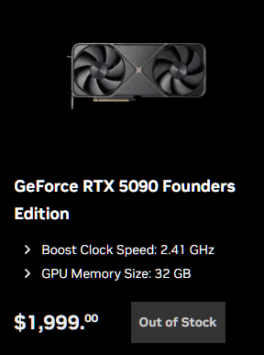
Parallel Programming Relevance
The end of Moore’s Law
Increased compute needs (AI, Growing Internet, Embarrassingly Parallel)
Growing computer cost
Difficult due to proprietary models

Slide 4
SYCL
SYCL created to compete with other frameworks
Community support for many devices – Still lacking in areas
Custom Device Selectors to choose the right tool for the job (CPU or GPU)
Two main memory models
Buffers: Allocate only specific sections to be used when the Compiler thinks is best
USM: Shared between CPU and GPU, User managed
Queue used to submit jobs and data to working device
An Open Standard

Slide 5
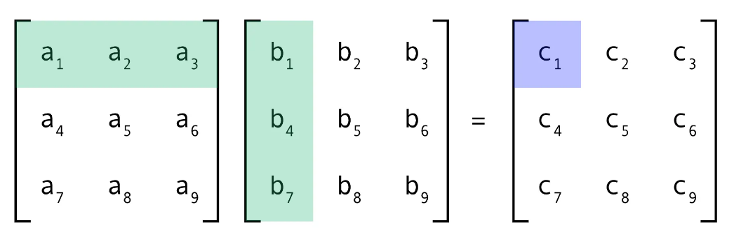
Matrix Multiplication
How it Works
Optimizations
Time Complexity: O(n*k*m)
Can be broken down several ways
Sum of the row of matrix a times the column of matrix b
Keep parallel programs simple
Keep them manageable
Lowering time complexity is the goal
O(n*k*m) with n workers could reduce the time complexity to O(k*m)

Slide 6
Matrix Multiplication Timings

Slide 7
Neural Network API Structure
Dense Layer Class controls Activation, Optimizer
Neural Network Class conducts training loop, job allocation… patience feature
Activation functions implemented include ReLU, Sigmoid, TanH, and Softmax
Adam Optimizer included to reduce prediction collapse to 1 class
Matrix Class
Uses raw double* to allocate contiguous memory for the matrix
Size is stored with the matrix object
Minimized the value copies in functions
Contains helper functions for size, element access, and common operations

Slide 8
Neural Networks
Input * Weights = Output
Modify weights to change output
The closer output is to the expected, the better your network
Job Allocation Scheme
age | sex | On thyroxine | Query on thyroxine | On antithyroid medication | sick | pregnant | Thyroid surgery | I131 treatment | Query hypothyroid | Query hyperthyroid | lithium | goitre | tumor | hypopituitary | psych | TSH | T3 | TT4 | T4U | FTI | class
0.29 | 0 | 0 | 0 | 0 | 0 | 0 | 0 | 0 | 0 | 0 | 0 | 0 | 0 | 0 | 0 | 0.0061 | 0.028 | 0.111 | 0.131 | 0.085 | 2
0.32 | 0 | 0 | 0 | 0 | 0 | 0 | 0 | 0 | 0 | 0 | 0 | 0 | 0 | 0 | 0 | 0.0013 | 0.019 | 0.084 | 0.078 | 0.107 | 3
0.35 | 0 | 0 | 0 | 0 | 0 | 0 | 0 | 0 | 0 | 0 | 0 | 0 | 0 | 0 | 0 | 0 | 0.031 | 0.239 | 0.1 | 0.239 | 3
0.21 | 0 | 0 | 0 | 0 | 0 | 0 | 0 | 0 | 0 | 0 | 0 | 0 | 0 | 0 | 0 | 0.001 | 0.018 | 0.087 | 0.088 | 0.099 | 3
0.22 | 0 | 0 | 0 | 0 | 1 | 0 | 0 | 0 | 0 | 0 | 0 | 0 | 0 | 0 | 0 | 0.0004 | 0.022 | 0.134 | 0.135 | 0.099 | 3
0.22 | 0 | 0 | 0 | 0 | 0 | 0 | 0 | 0 | 0 | 0 | 0 | 0 | 0 | 0 | 0 | 0.0016 | 0.02 | 0.123 | 0.113 | 0.109 | 3
0.39 | 0 | 0 | 0 | 0 | 0 | 0 | 0 | 0 | 0 | 1 | 0 | 0 | 0 | 0 | 0 | 0.0016 | 0.036 | 0.133 | 0.144 | 0.093 | 3
0.77 | 1 | 0 | 0 | 0 | 0 | 0 | 0 | 0 | 0 | 0 | 0 | 0 | 0 | 0 | 0 | 0.00081 | 0.02 | 0.08 | 0.096 | 0.08316 | 3
0.23 | 0 | 0 | 0 | 0 | 0 | 0 | 0 | 0 | 0 | 0 | 0 | 0 | 0 | 0 | 0 | 0.00025 | 0.014 | 0.113 | 0.096 | 0.11746 | 3
0.23 | 0 | 0 | 0 | 0 | 0 | 0 | 0 | 0 | 0 | 0 | 0 | 0 | 0 | 0 | 0 | 0.0026 | 0.011 | 0.104 | 0.104 | 0.099 | 3
0.45 | 1 | 0 | 0 | 0 | 0 | 0 | 0 | 0 | 0 | 0 | 0 | 0 | 0 | 0 | 0 | 0.061 | 0.006 | 0.023 | 0.087 | 0.026 | 1
0.65 | 0 | 1 | 0 | 0 | 0 | 0 | 0 | 1 | 1 | 0 | 0 | 0 | 0 | 0 | 0 | 0.00003 | 0.023 | 0.154 | 0.09 | 0.17 | 3
0.53 | 0 | 0 | 0 | 0 | 0 | 0 | 0 | 0 | 0 | 1 | 0 | 0 | 0 | 0 | 0 | 0.00004 | 0.022 | 0.115 | 0.093 | 0.124 | 3
0.79 | 0 | 0 | 0 | 0 | 0 | 0 | 0 | 0 | 0 | 1 | 0 | 0 | 0 | 0 | 0 | 0.00419 | 0.011 | 0.078 | 0.097 | 0.081 | 3

Slide 9
Neural Network Training Timings

Slide 10
Vs. PyTorch
On the Thyroid Dataset

Slide 11
Model Performance
Actual | Confusion Matrix
Hyperthyroid | 66 | 7 | 0
Hypothyroid | 0 | 163 | 14
Normal | 12 | 17 | 1471
 | Hyperthyroid | Hypothyroid | Normal | Predicted
Precision: 97.3%
Recall: 97.1%
F1: 97.2%
Overall Weighted Metrics

Slide 12
What’s Next?
Limitations
Future Work
Non-Square Matrices
Small Weight Matrices
GPU Utilization
GPU Acceleration via Adaptive CPP
Larger Datasets
Improved optimizations

